Slide 1
Particle (photon)
Light
Wave (electromagnetic wave)

Slide 2
Chapter 39 Light Waves

Slide 3
Content of This Chapter
The electromagnetic spectrum
Visible light
The speed of light
Reflection and refraction of light waves
Total internal reflection
The Doppler effect for light

Slide 4
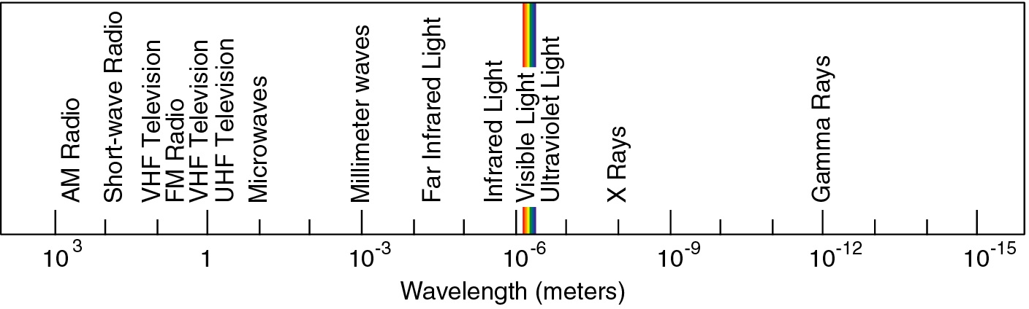
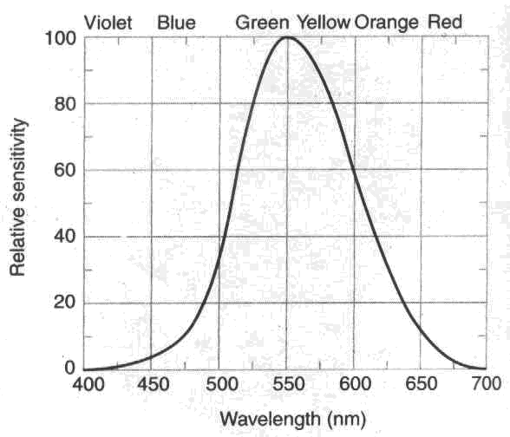
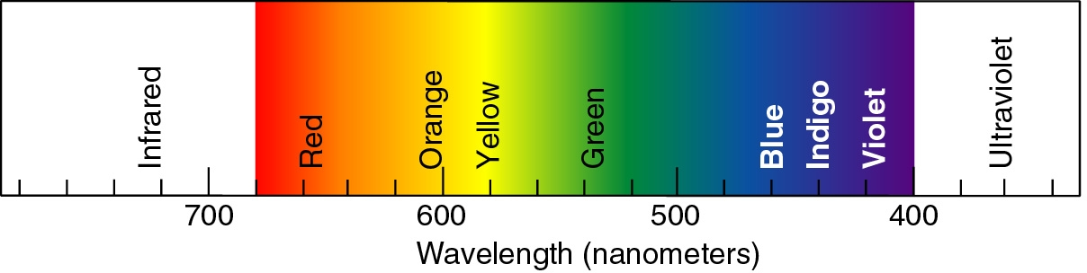
Electromagnetic Spectrum:
Radio waves
visible region
X rays
Gamma rays
Microwaves
Infrared radiation
Ultraviolet
The sensitivity of the human eye as a function of wavelength

Slide 5
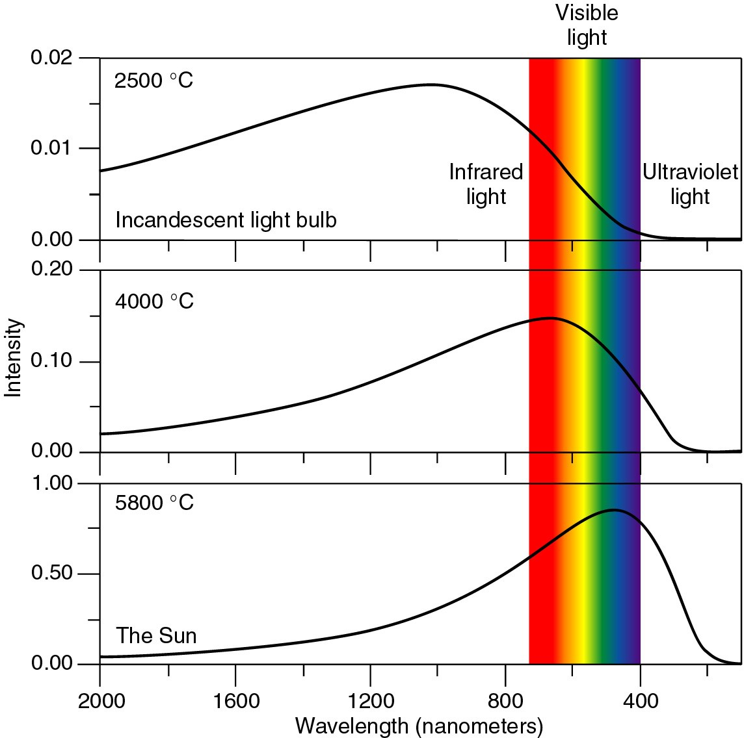
The Wavelength vs Temperature

Slide 6
The Wavelength vs Temperature

Slide 7
The Wavelength vs Temperature

Slide 8
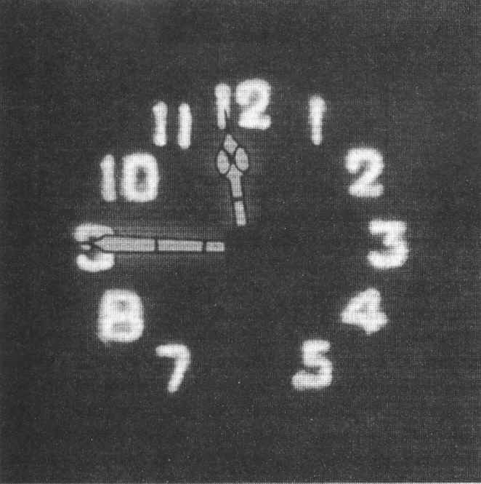
Thermal radiation—the sun light
Luminescence—cool light source
Matel
Organic
ITO
Glass
φ₁
φ₂
φ₃

Slide 9
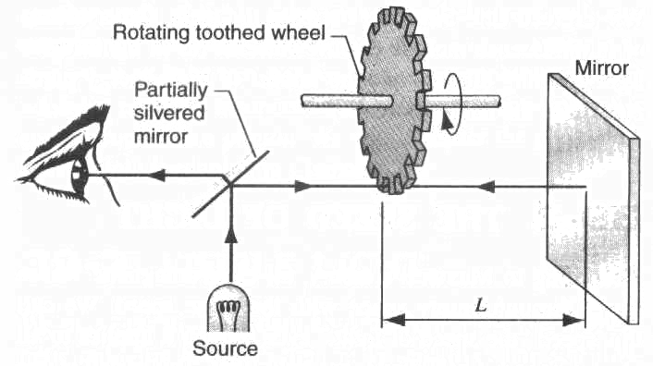
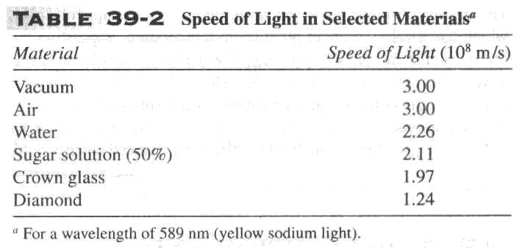
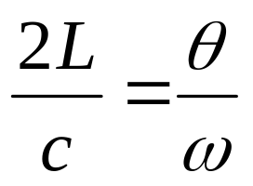
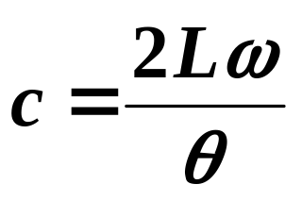
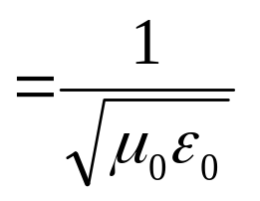



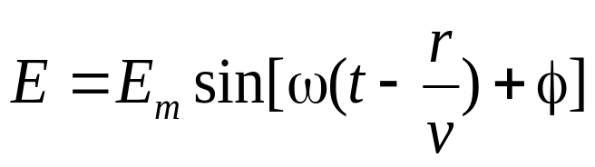
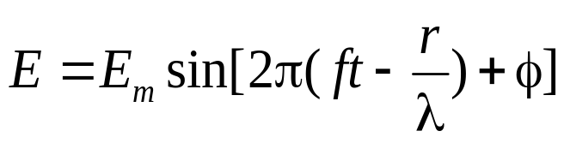
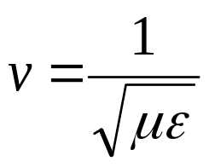
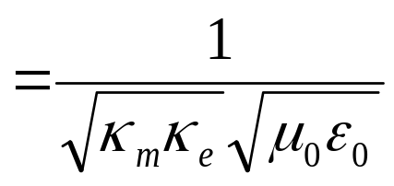
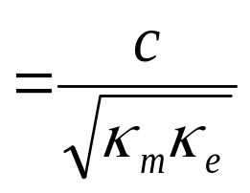
The speed of light
Propagation of light in matter
The phase change
The speed of light in a material depends on the the frequency or wavelength.

Slide 10
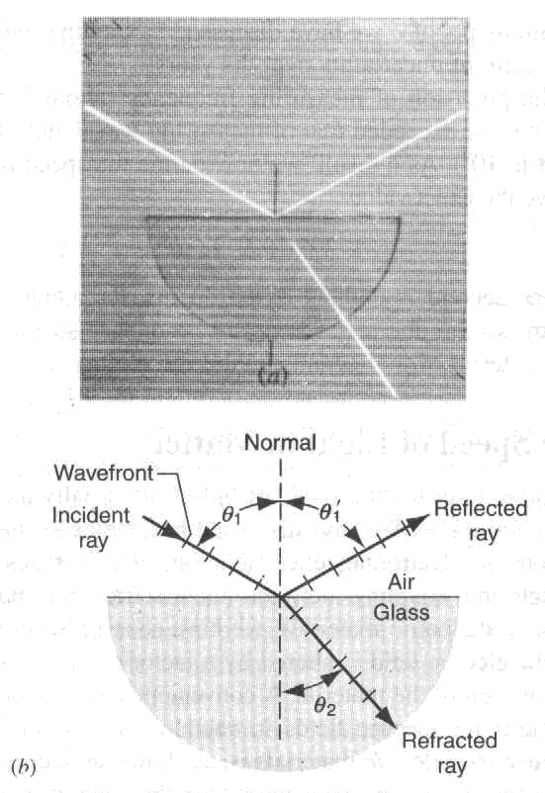
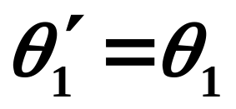

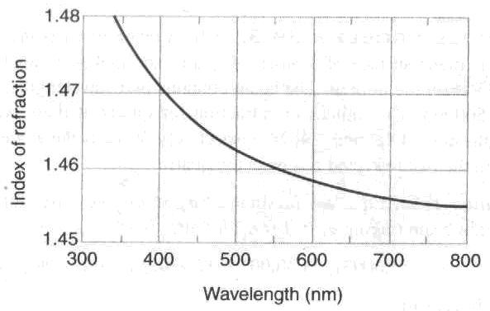
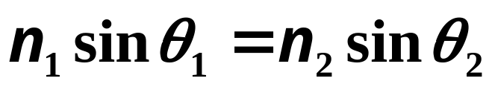
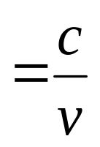
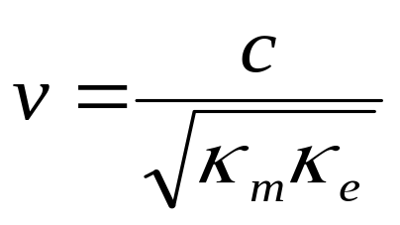
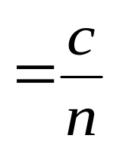
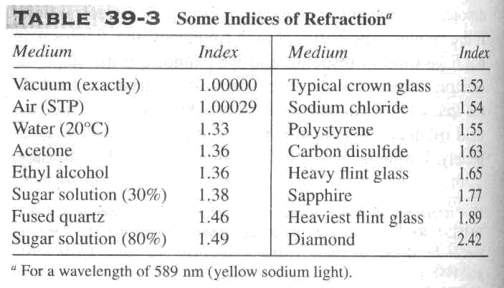
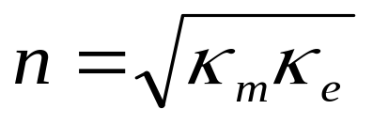
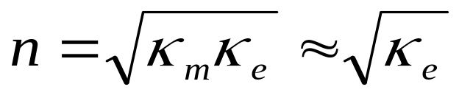
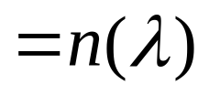
Reflection and refraction of light waves
Reflection:
Refraction:
Index of refraction: n

Slide 11
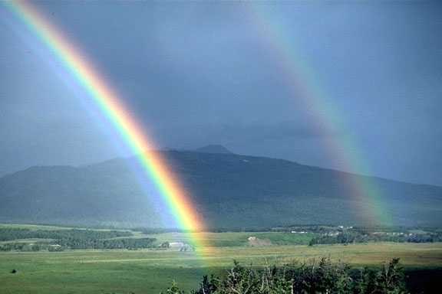
rainbow
In second rainbow pattern is reversed

Slide 12
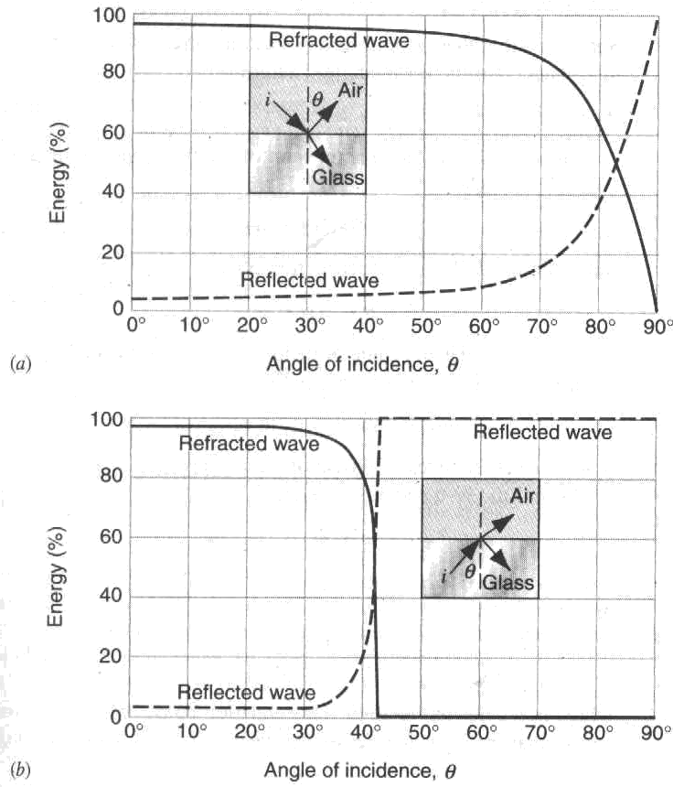
Reflection and refraction of electromagnetic waves

Slide 13
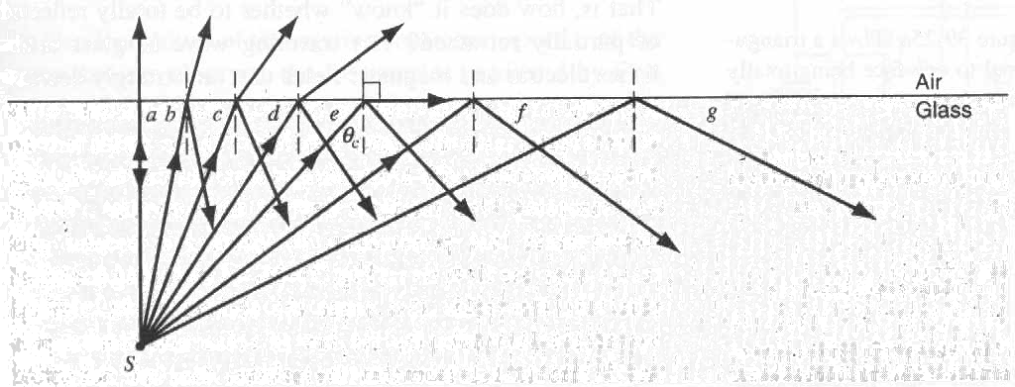
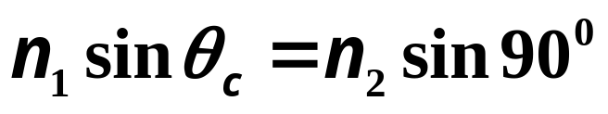
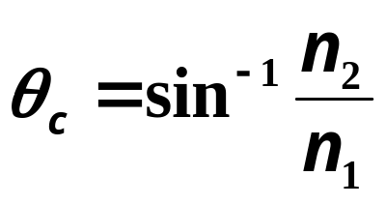
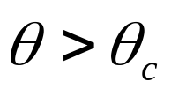
Reflection and refraction of electromagnetic waves
In case of n_{i} larger than n_{R}
Total Internal Reflection

Slide 14
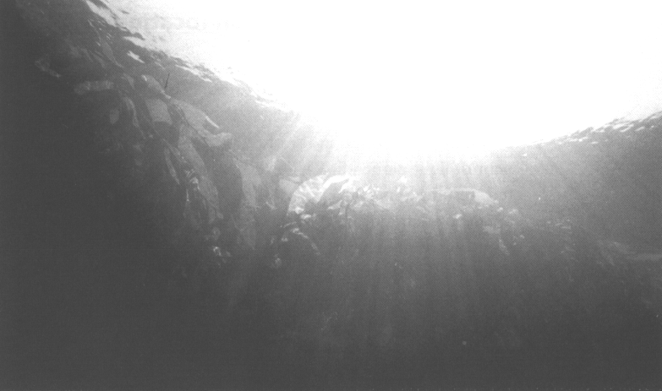
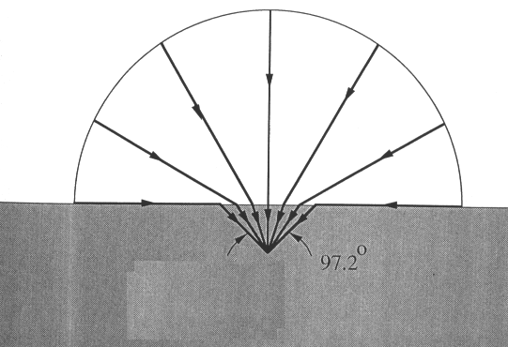
Examples: refraction at water/air interface
Diver’s illusion
Diver sees all of horizon
refracted into a 97°cone.

Slide 15
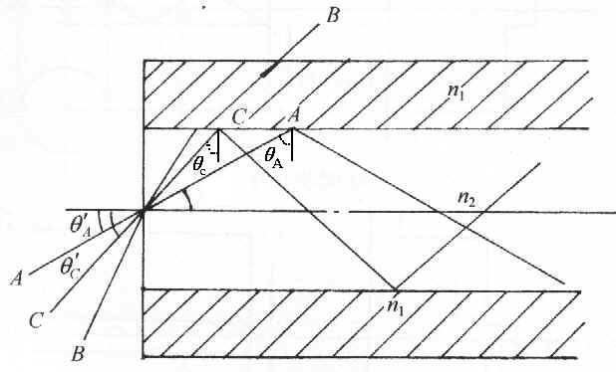
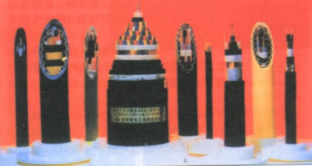
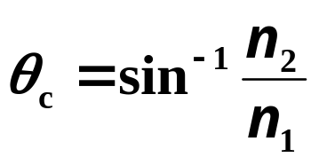
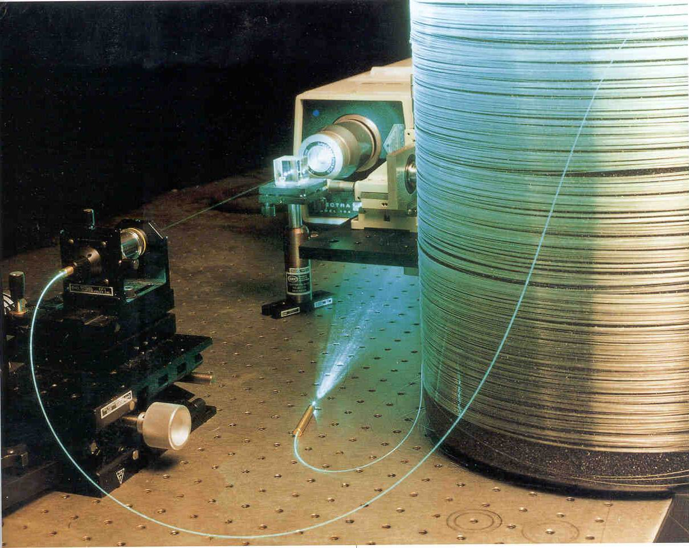
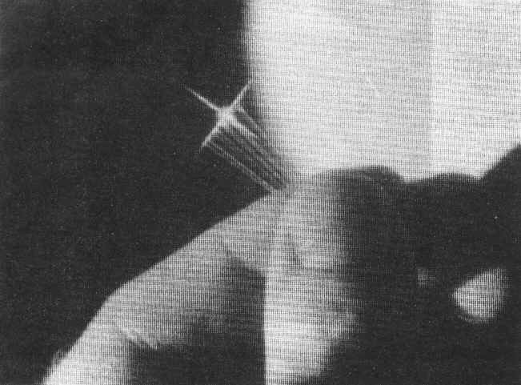
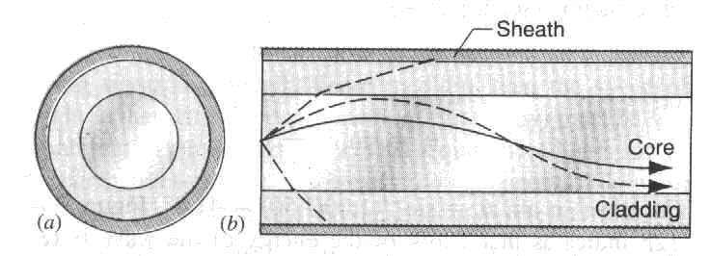
Optical fiber
Optical fiber:
At each contact the glass air interface, if the light hits at greater than the critical angle, it undergoes total internal reflection and stays in the fiber.
n_{outside}
n_{inside}
Total Internal Reflection only works if n_{outside} < n_{inside}

Slide 16
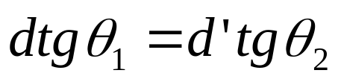
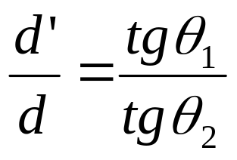
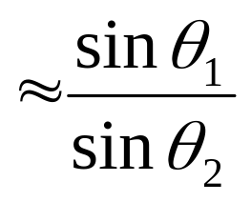
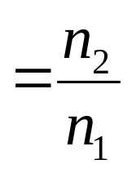

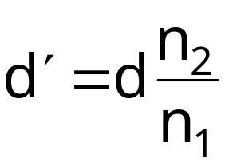
Apparent Depth
Apparent depth:
n₂
a
θ₂
n₂
n₁
P
n₁
d′
θ₁
d’
θ₂
d
apparent fish
θ₁
d
B
actual fish
50

Slide 17
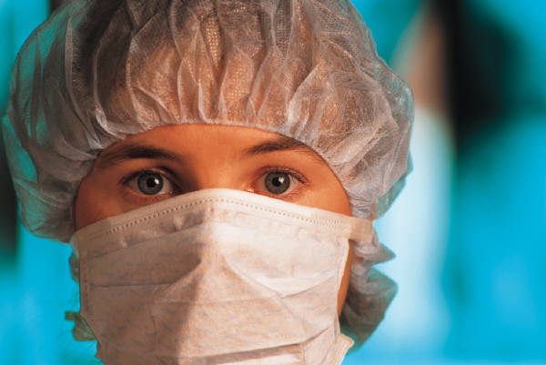

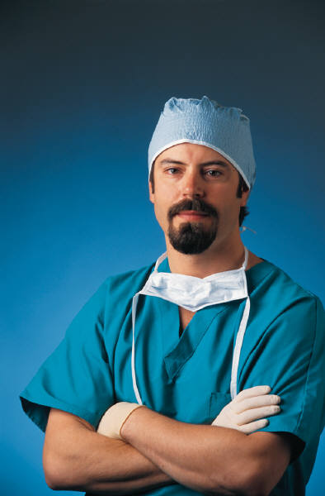
ACT: Refraction
As we pour more water into bucket, what will happen to the number of people who can see the ball?

Slide 18
ACT: Refraction
As we pour more water into bucket, what will happen to the number of people who can see the ball?

Slide 19
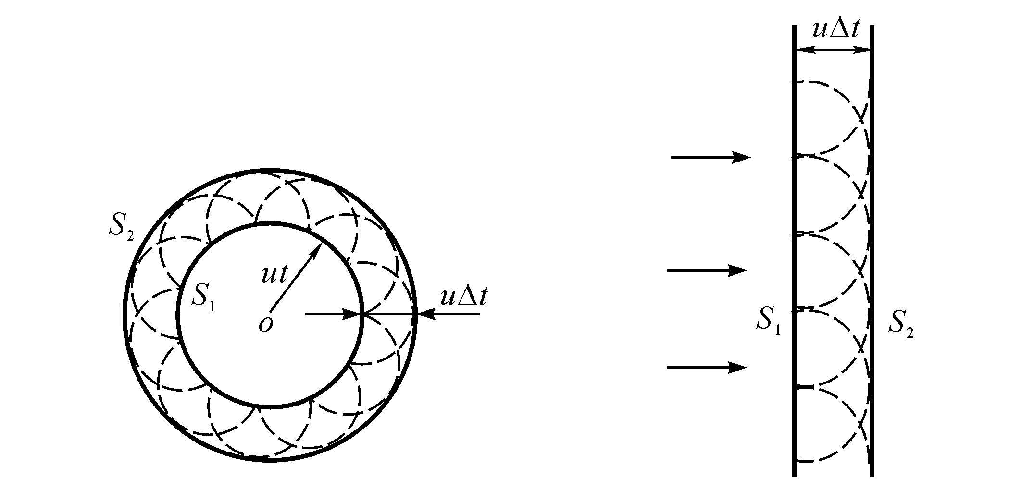
Deriving the law of reflection
Huygens’ Principle:
All points on a wavefront can be considered as point sources for the production of spherical secondary wavelets. After a time t the new position of a wavefront is the surface tangent to these secondary wavelets.

Slide 20
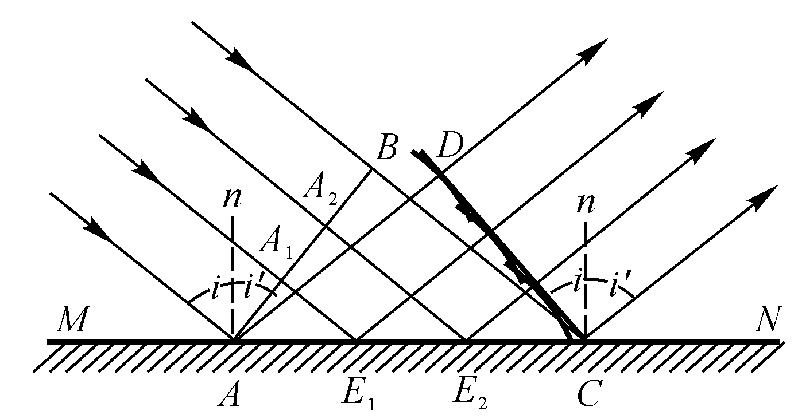




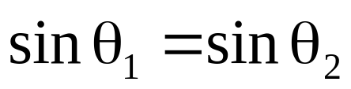


Slide 21






Deriving the law of refraction
θ₁
n₁
θ₁
n₂
θ₂
C
θ₂
n₁ ≠ n₂ ⇒ v₁ ≠ v₂
θ ₁ cannot equal θ ₂ !

Slide 22








Fermat’s Principle:
A light ray traveling from one fixes point to another fixed point follows a path such that, compared with nearby paths, the time requires is either a minimum or a maximum or remains unchange (that is, stationary).
B
A
A
B
θ₁
θ´₁
a
b
x
d-x
P
d

Slide 23






A
θ₁
a
n₁
x
n₂
P
θ₂
b
d
B

Slide 24







Snell’s Law
λ₁
θ₁
θ₁
L
θ₁
n₁
θ₂
θ₂
θ₂
n₂
λ₂
θ₂
The two triangles above each have hypotenuse L

Slide 25

Why is the sky blue?
Light from Sun scatters off of air particles––
Rayleigh scattering is wavelength-dependent, More scatter for shorter wavelengths (blue end of the visible spectrum)
Less scatter for longer wavelengths (red end of the visible spectrum)

Slide 26

Shorter wavelengths scatter more
longer wavelengths scatter less
Sun light
red and orange
blue
This is also why sunsets are red

Slide 27



The Doppler effect for light
1. Sound wave, observer fixed, source moving away
2. Sound wave, source fixed, observer moving away
3. Light wave, source and observer separating

Slide 28














*
o
u
u
*
o
Source leaving

Slide 29

*
o
u
u
*
o
Source leaving
Source approaching

Slide 30




u
o
θ
*
*
o
θ
*
u
cosθ
Source leaving
Source approaching

Slide 31














Example

Slide 32











Example

Slide 33


Example

Slide 34







Example

Slide 35








Example
A detector on the earth surface receives a radio signal from a satellite with a relative speed of 8.0 km/s at an acceptance angle of about 10 degree in the both cases of coming and leaving relatively from the detector. The satellites emit radio wave with a typical frequency of 122.45 Hz. Find the frequencies at the detector in both cases.
8.0 km/s
in the cases of coming

Slide 36
Homework:
P906-908 19, 36, 44
P910-911 7, 12

